Slide 1
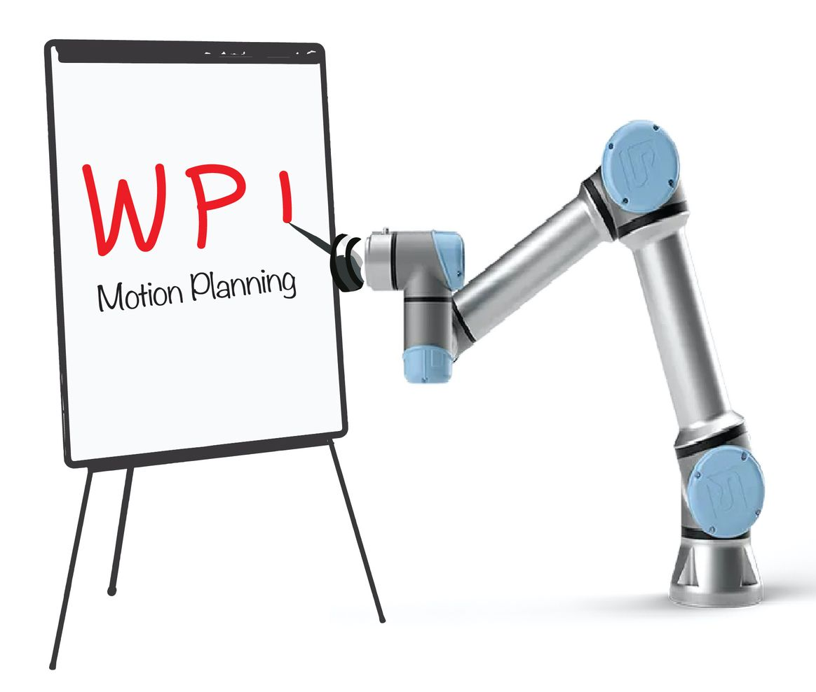
RBE550
Motion Planning OMPL Overview
Constantinos Chamzas www.cchamzas.com www.elpislab.org

Slide 2
Disclaimer and Acknowledgments
The slides are a compilation of work based on notes and slides mainly from Zak Kingston, , but also Ali Golestaneh

Slide 3
Overview
OMPL at High Level
OMPL Internals

Slide 4
OMPL at High Level

Slide 5
What is OMPL?
OMPL is a C++11 Library (with automatically generated Python Bindings), intended for industrial, educational, and academic use, which has:
Core data-structures for sampling-based planners
Commonly used heuristics, components, etc.
Implementation of many state-of-the-art sampling-based planners
With details of many low-level details skipped in their corresponding papers!

Slide 6
What is OMPL not?
OMPL does not:
• Represent robot and scene geometry
• Compute forward and inverse kinematics
• Provide collision checking routines
• Simulate robot dynamics
• etc.
OMPL is an abstract library that you must provide the guts for!

Slide 7
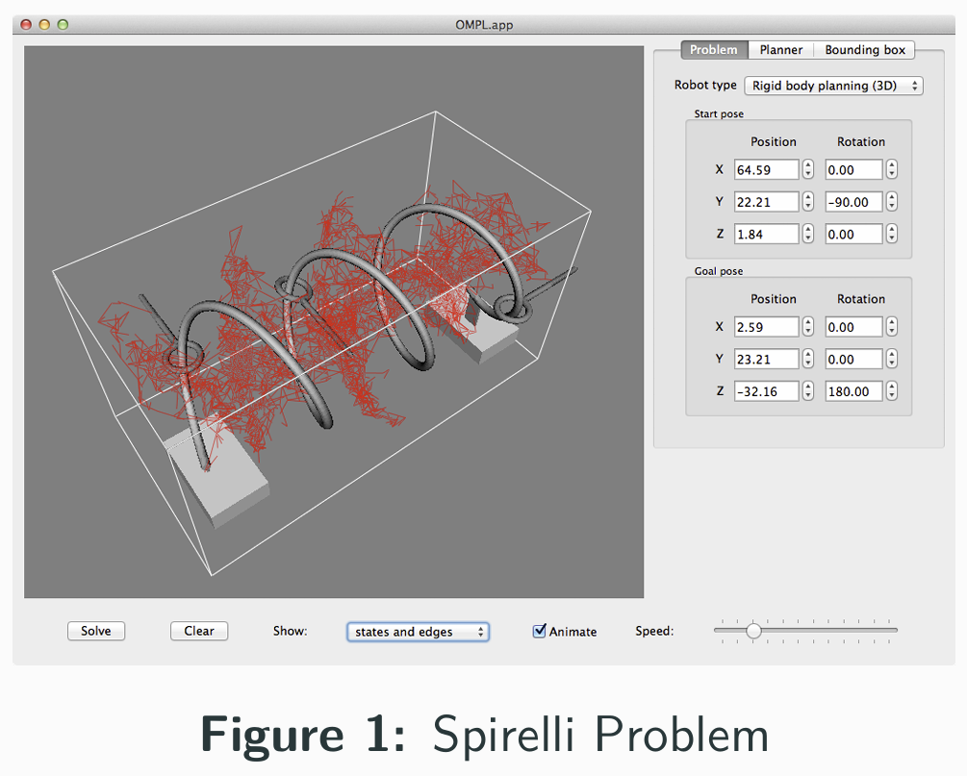
What is OMPL.app?
OMPL.app is a lightweight GUI front-end to OMPL that uses a triangle mesh representation of free-flying robots in an environment

Slide 8
OMPL Internals

Slide 9
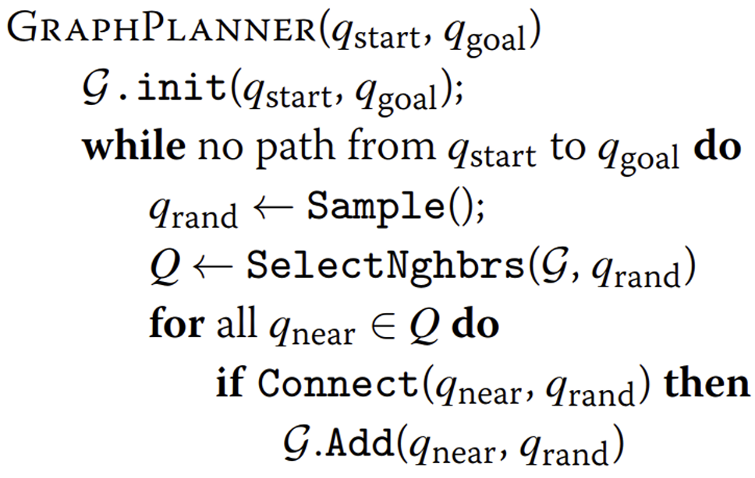
Sampling-Based Planners
Figure 2: A Simple Graph-based Sampling-based Planner

Slide 10
OMPL is an Abstract Interface
OMPL requires you to define all the components of a motion planning problem:
State Space e.g., the configuration space
State Validator e.g., a collision checker
State Sampler e.g., a uniform sampler
Start & Goal e.g., start and goal states
Motion Planner Pick your favorite!
And so on...
These are specific to your robot and environment, your motion planner, and your problem!

Slide 11
OMPL is an Abstract Interface
OMPL requires you to define all the components of a motion planning problem:
State Space e.g., the configuration space
State Validator e.g., a collision checker
State Sampler e.g., a uniform sampler
Start & Goal e.g., start and goal states
Motion Planner Pick your favorite!
And so on...
These are specific to your robot and environment, your motion planner, and your problem!

Slide 12
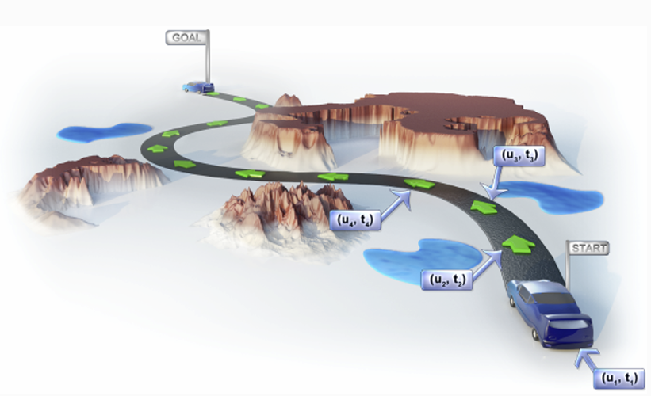
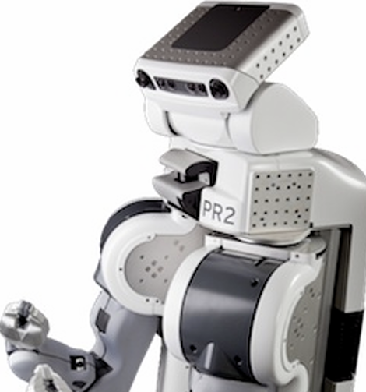
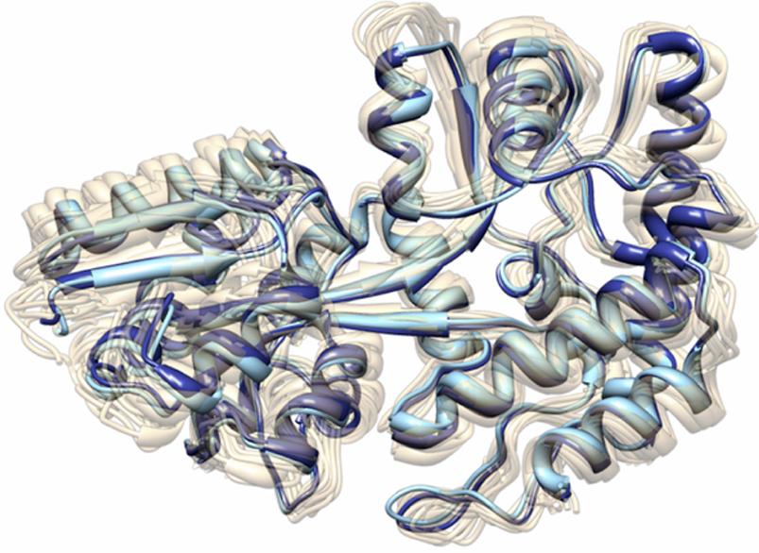
States & State Spaces

Slide 13
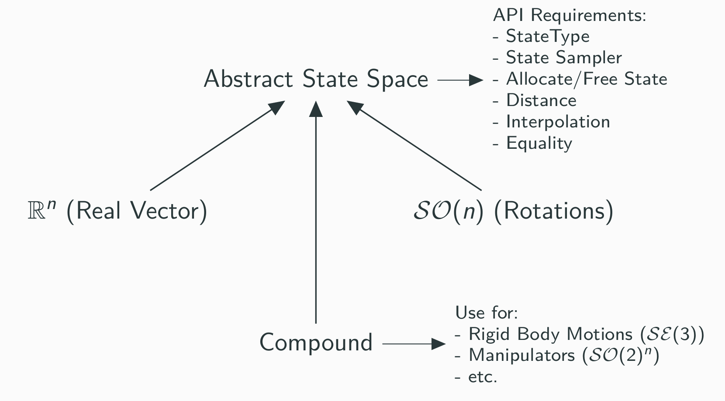
States & State Spaces

Slide 14
OMPL is an Abstract Interface
OMPL requires you to define all the components of a motion planning problem:
State Space e.g., the configuration space
State Validator e.g., a collision checker
State Sampler e.g., a uniform sampler
Start & Goal e.g., start and goal states
Motion Planner Pick your favorite!
And so on...
These are specific to your robot and environment, your motion planner, and your problem!

Slide 15
State Validators
The state validator is problem specific, and must be defined by the user / layer on OMPL.
• e.g., OMPL.app, MoveIt!, V-REP, and the list goes on...
For a robot, this could be a collision checker, are joint angles in bounds, etc.
For a molecule, this could be the energy of the state, use the metropolis criterion, etc.
Optionally, state validators can return:
• Distance to nearest invalid state (i.e., obstacle)
• Gradient of distance
Which planners and other components can use!

Slide 16
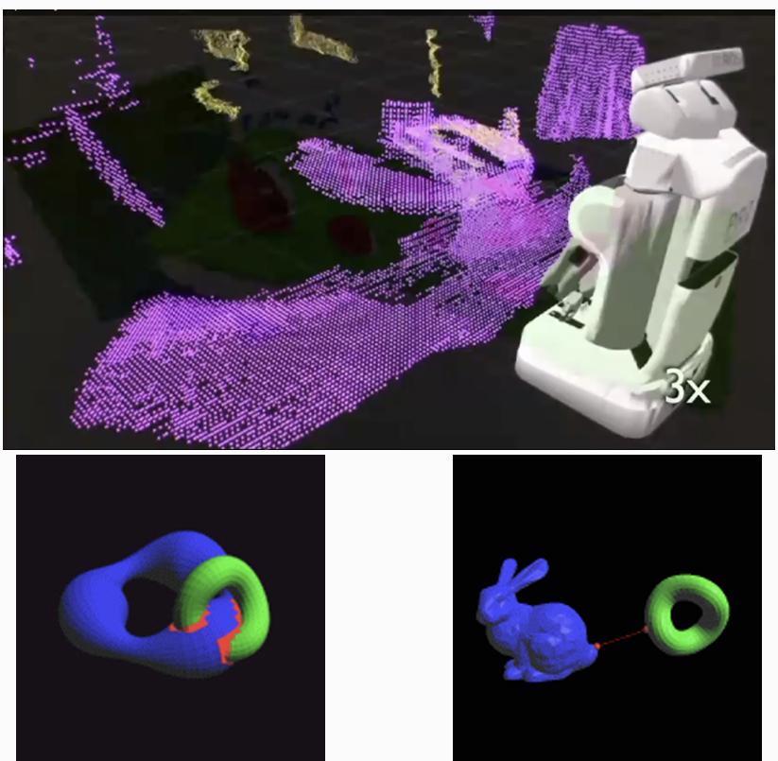
Collision Checking
To do collision checking, you must first choose a model of the world (e.g., point clouds, triangle meshes, etc.)
• ROS (robot operating system, common middleware used in robotics) offers a sensor-driven world model with point clouds (represented as octrees) and
triangle meshes.
• OMPL.app uses triangle meshes and FCL (flexible collision library) for collision checking.
• Easy to add wrappers to whatever collision checker you want!
Images from pointclouds.org and PQP site

Slide 17
OMPL is an Abstract Interface
OMPL requires you to define all the components of a motion planning problem:
State Space e.g., the configuration space
State Validator e.g., a collision checker
State Sampler e.g., a uniform sampler
Start & Goal e.g., start and goal states
Motion Planner Pick your favorite!
And so on...
These are specific to your robot and environment, your motion planner, and your problem!

Slide 18
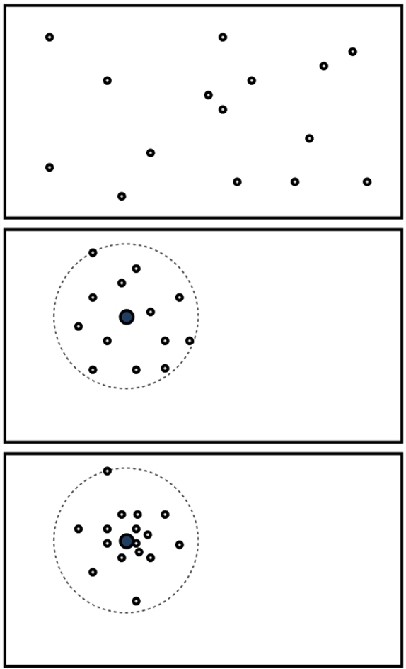
State Samplers
Every State Space needs a State Sampler
• Sample Uniformly
• Sample Nearby
• Sample from a Gaussian
These can be specialized (i.e., biased), e.g., bridge test, experience-based, medial axis, etc.

Slide 19
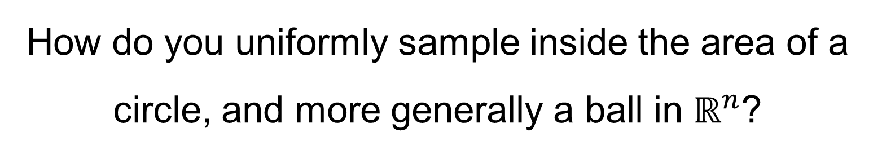
How to Sample Uniformly in Different Spaces?
How do you uniformly sample inside the area of a circle, and more generally a ball in $ℝ^{n}$?

Slide 20
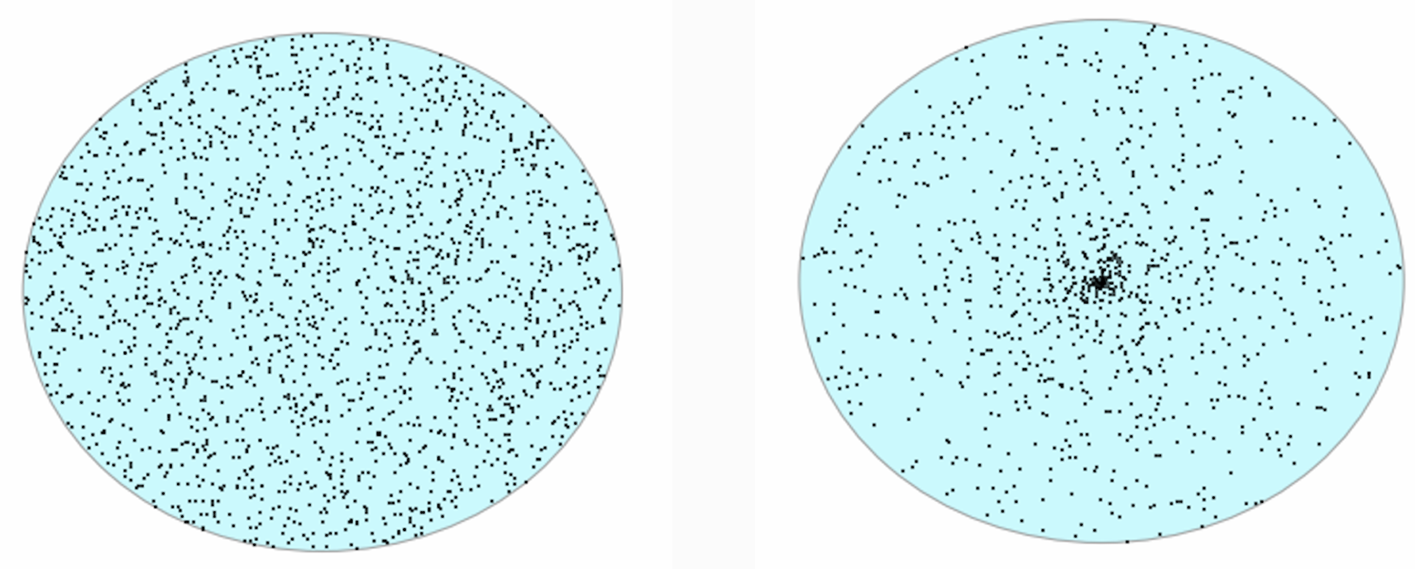
How to Sample Uniformly in Different Spaces?
Right:
Wrong:

Slide 21
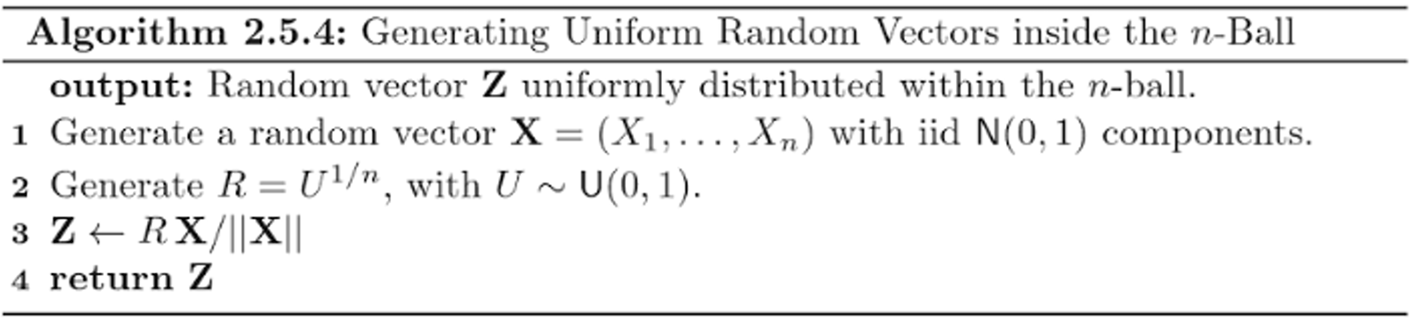
Marsaglia n-Ball Sampling
Marsaglia, G. ”Choosing a Point from the Surface of a Sphere.” Ann. Math. Stat. 43, 645-646, 1972.

Slide 22
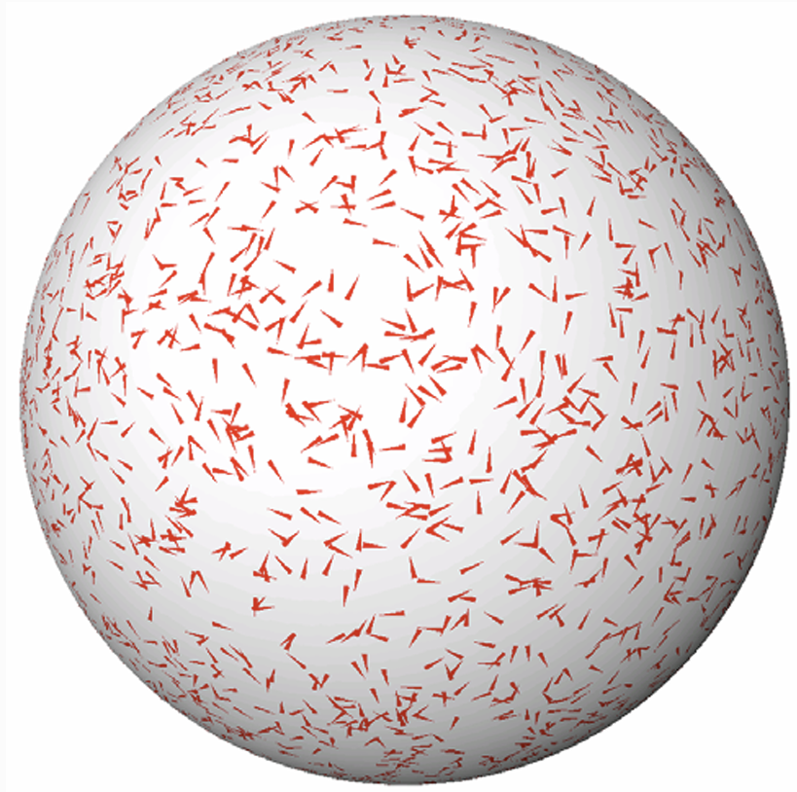
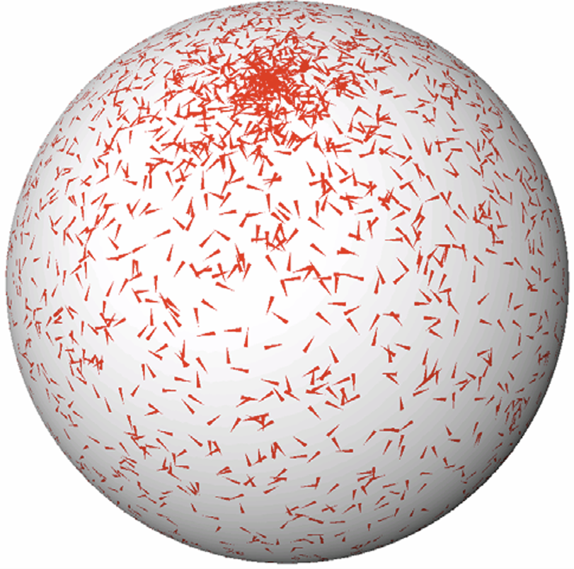
So Many Ways to Get Sampling Wrong
e.g., 3D Rotations:
Right:
Wrong:

Slide 23
Nearest Neighbors
A nearest neighbor datastructure (NN) is essential for most sampling-based planners. NNs allow for efficient lookup of spatial similar points.
k-NN (the k nearest neighbors to a point) can be computed efficiently with kd-trees in low-dimensional, Euclidean (Rn) spaces.
In high-dimensional spaces, approximate NN works much better.
In non-Euclidean spaces (e.g., any space with rotations), data structures other than kd-trees are necessary. OMPL provides a few implementations (GNATs for metric spaces, etc.).

Slide 24
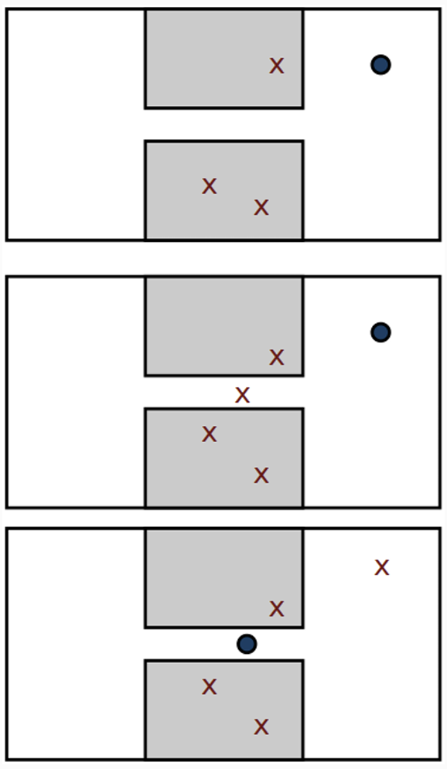
Valid State Samplers
Valid State Samplers combine State Samplers with Validity Checkers.
In the simplest form: sample n times until the state is valid.
Can try other strategies, like finding states with high clearance or in narrow regions.

Slide 25
OMPL is an Abstract Interface
OMPL requires you to define all the components of a motion planning problem:
State Space e.g., the configuration space
State Validator e.g., a collision checker
State Sampler e.g., a uniform sampler
Start & Goal e.g., start and goal states
Motion Planner Pick your favorite!
And so on...
These are specific to your robot and environment, your motion planner, and your problem!

Slide 26
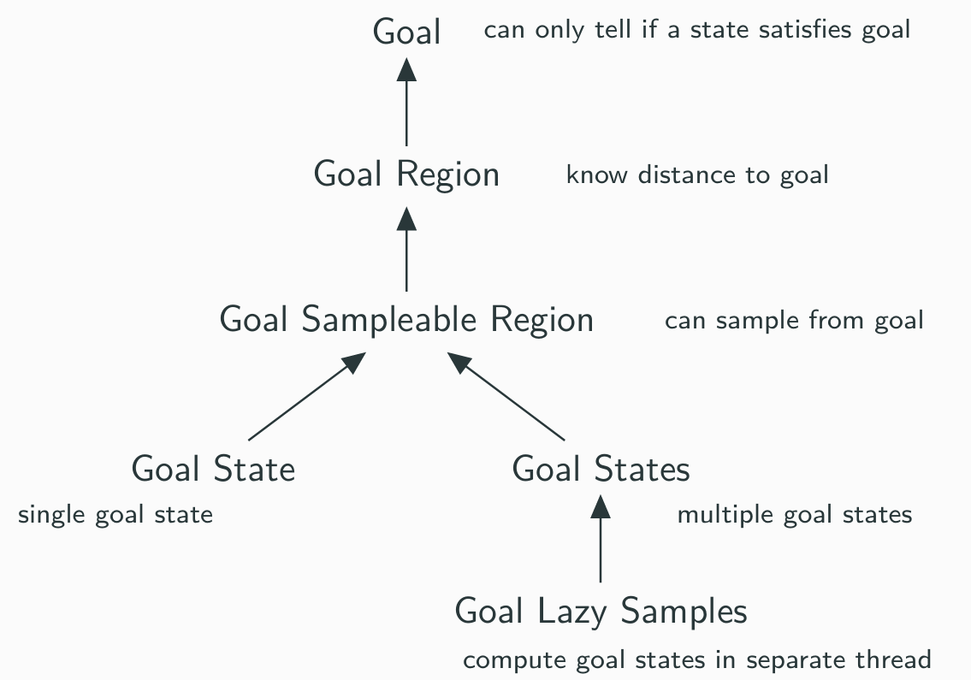
Goals

Slide 27
OMPL is an Abstract Interface
OMPL requires you to define all the components of a motion planning problem:
State Space e.g., the configuration space
State Validator e.g., a collision checker
State Sampler e.g., a uniform sampler
Start & Goal e.g., start and goal states
Motion Planner Pick your favorite!
And so on...
These are specific to your robot and environment, your motion planner, and your problem!

Slide 28
Planners
Planners take in as input Problem Definitions. Problem definitions have at least one start state and a goal object.
Planners only need to implement two methods:
• solve: Takes a Planner Termination Condition as an argument. This can be based on time, external events, etc.
• clear: Clear internal memory, get ready to solve another problem

Slide 29
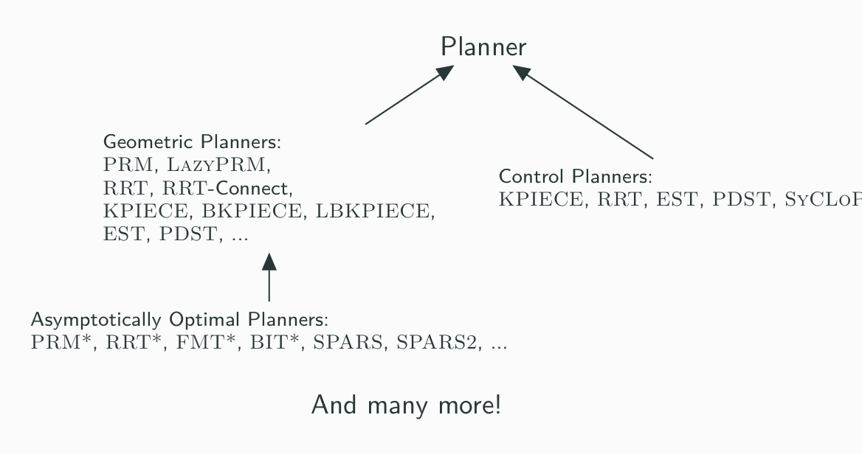
Many Planners Available in OMPL

Slide 30
The OMPL Bifurcation
There are two main namespaces in OMPL:
• geometric: Planning for rigid bodies with geometric constraints (e.g., manipulators, free-flying bodies, in general holonomic robots). This will be Project 3.
• control: Planning for systems with dynamical constraints (e.g., cars, torque controlled manipulators, generally non-holonomic robots). This will be Project 4.

Slide 31
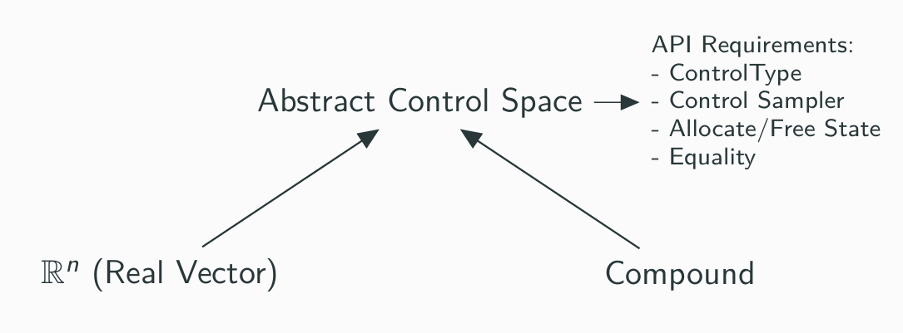
Control Spaces

Slide 32
Summing Up…

Slide 33
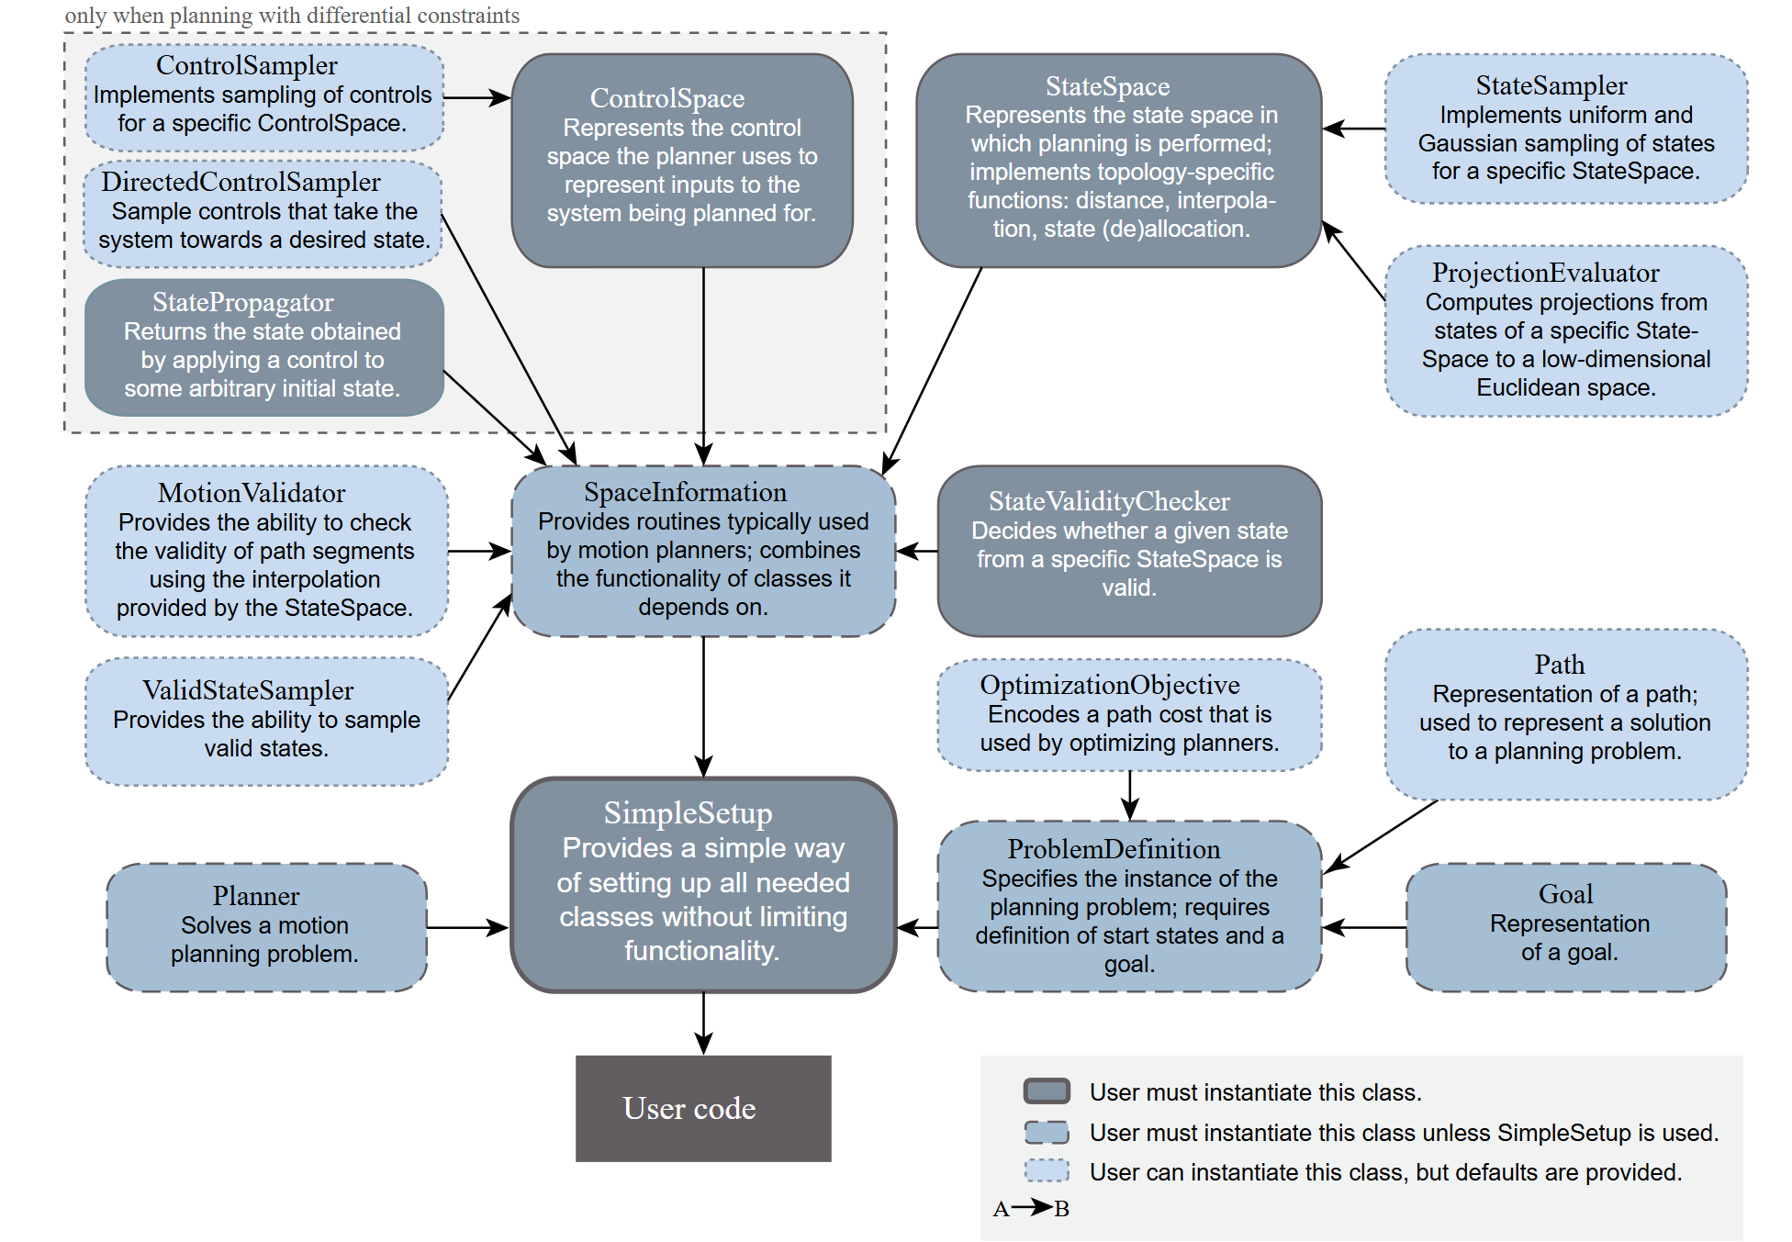
API Overview

Slide 34
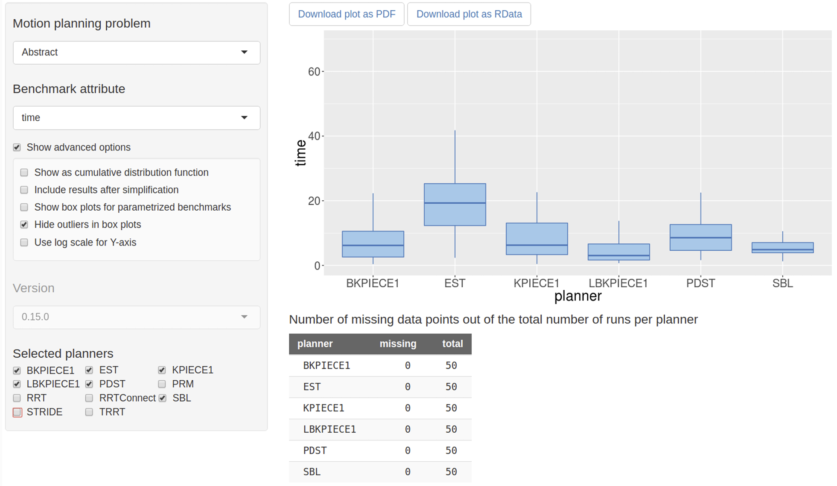
Planner Arena (http://plannerarena.org)

Slide 35
OMPL Online
Website at http://ompl.kavrakilab.org/, with:
• Searchable documentation
• Tutorials
• Demos
• and More!

Slide 36
Live Demo!

